Slide 1

CI / CD – Azure Pipelines
Ing Ops DevSchool
17th of May 2022

Slide 2

Course
Topics
01.
02.
03.
What and Why?
Classic pipelines
Pipeline as code
General concepts and definitions to get you going in this amazing journey:
What is CI / CD
Why do we need it
What is Azure
What is Azure DevOps
Repositories
Start your journey in the world of CI / CD with Azure classic pipelines:
What are Azure Pipelines
Build and Release
Variables
Service connections
Access tokens
Step up the automation game and provide CI / CD pipelines as code:
What are .yaml pipelines
Orchestration
Pipeline templates
Expressions and Instructions
Agents
Notes:
First click will make all cards appear using a smooth transition from left to right.
Second click will enlarge the first card (use when explaining the first module)
Third click will minimize first card and enalrge second card (use when explaining the second module)
Fourth click will minimize second card and enlarge the third one (use when explaining the third module)
NOTE: Not all topics are added here. (they are included in topics listed)

Slide 3

03. Pipeline
as code

Slide 4


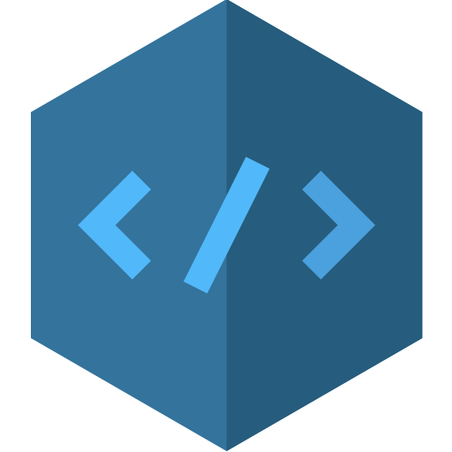

What is
Pipeline as Code ?
It represents a practice of pipelines through source , which is trackable and stored in a
defining build and deployment
code
centralized source repository.

Slide 5
Pipeline as Code
Advantages
Improves software delivery via automation
Allows more freedom for the developer
Easy to write & read (natively YAML files)
Enables collaboration and knowledge sharing
Code is version controlled (Git)
Changes are added using code review (PR)
Defining build and deployment pipelines in code
Improves the software delivery process and greatly increases automation by eliminating manual recurrent tasks performed by developers
Language used to write pipelines as code
The “as code” approach enables developer teams to define their pipelines using various declarative approaches like .YAML or using a vendor specific programming language such as Jenkings, Groovy, etc.
Keeping track of pipeline versions
Disadvantages
Version control, also known as source control, is the practice of tracking and managing changes to software code. Creating pipelines as code, enables developers to keep track of the changes done over time and enables more team collaboration through code-review process
Steep learning curve
Pipeline code needs to be tested

Slide 6
Pipeline Orchestration – the big 5
Stage
A stage is a logical boundary in the pipeline. It can be used to mark separation of pipeline execution phases. A pipeline can contain one or multiple stages, each having a unique name.
Job
A stage contains one or more jobs. Each job represents a logical boundary under which a set of instructions can be executed. Jobs are usefull when executing instructions using different environment configurations (e.g. one job using linux based OS, and another using Windows)
Step
A step is the smallest building block of a pipeline. Steps are always hierarchically listed under jobs, but can also run as standalone if no other job/stage is defined. A step can either be a script or a task. A task is simply a pre-created script offered as a convenience
Agent
An agent is the computing infrastructure with installed agent software that runs one job at a time. Jobs defined in the pipeline can run on an agent or be agentless. There are multiple types of agents, depending on the necessity.
Triggers
A trigger represents the action that tells the pipeline to initiate a new run. Triggers can be configured to run a pipeline on various actions like committing code, another pipeline finishing, etc.

Slide 7



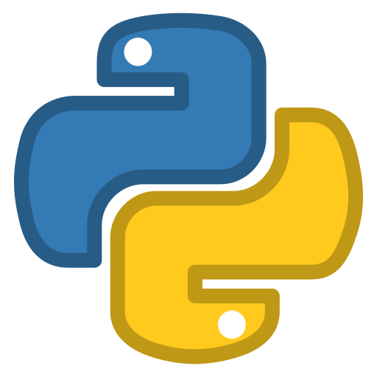
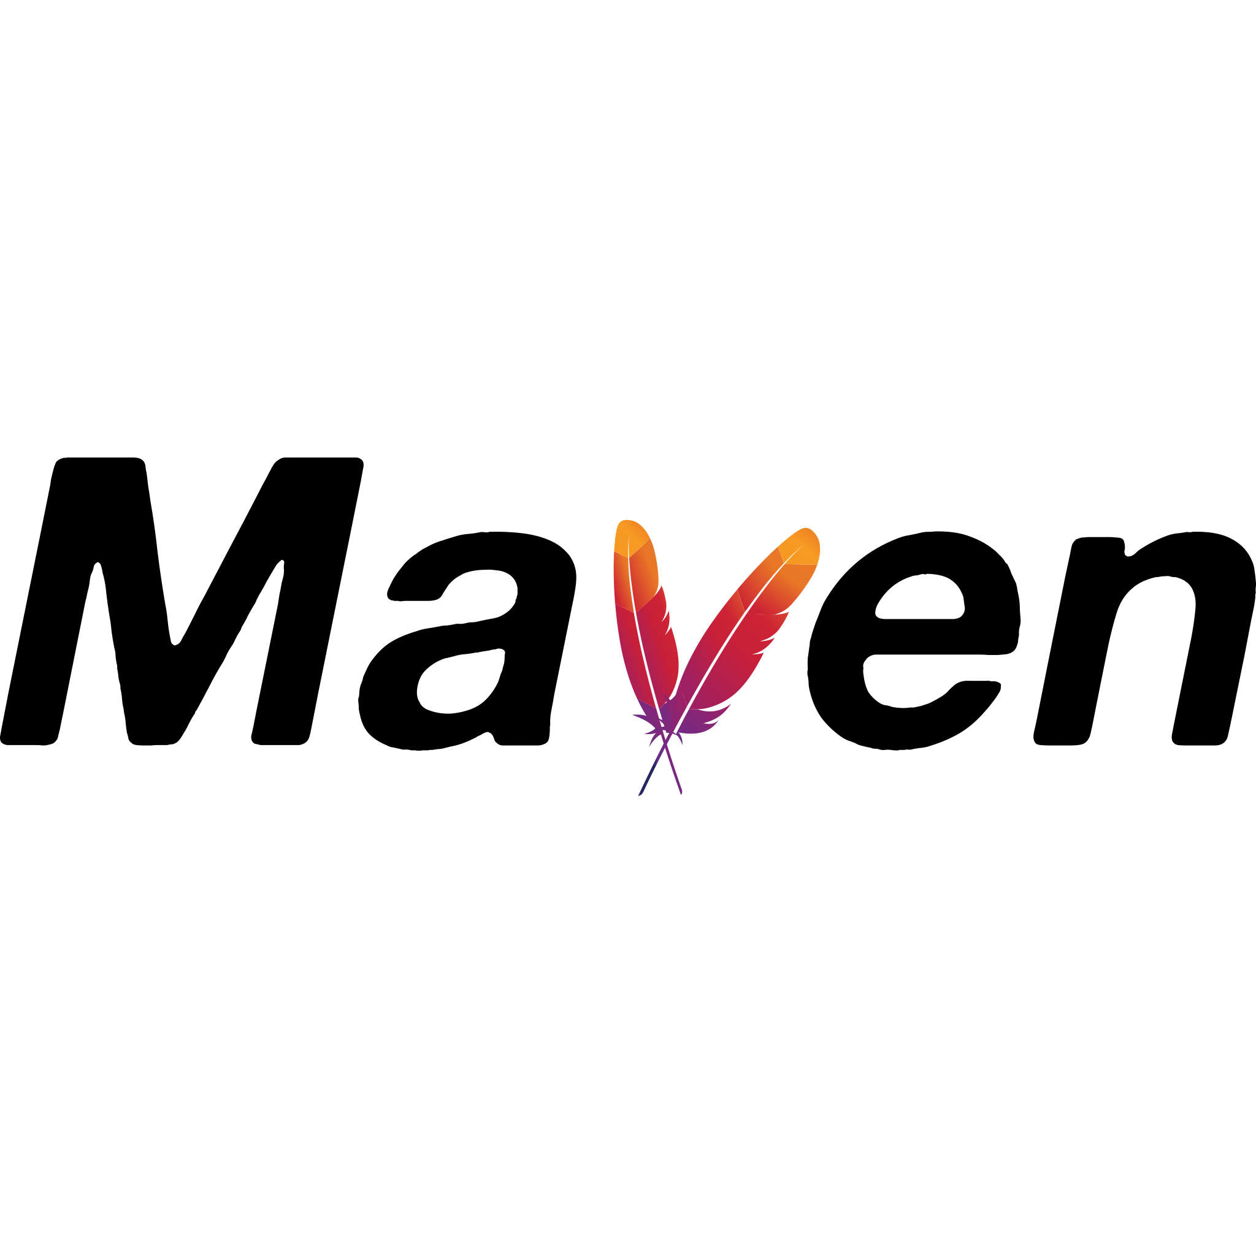
Pipeline Orchestration
(Manual, Push to repository, Schedule, Build completion)
Trigger
Steps
Step: script
Bash script
Step: task
Download artifact
Stage 1
Stage 3
BUILD
Stage 2
TEST
DEPLOY
Step: task
Agent (Ubuntu)
Job
Agent (Windows)
Job
Steps
Step: script
Python script
Step: task
Maven build
Step: task

Slide 8
Pipeline Orchestration - Stages
YAML Syntax
stages:
#When defining one or more stages, definition must start with ‘stages’ keyword
- stage: my_first_stage
#Stage definition must contain a unique name (A-Z, a-z, 0-9 and underscore)
displayName: ‘My First Stage’
#Name of the stage that will be displayed in the GUI when running
pool: ‘agentName’
#Name of the agent which will be used by default for this stage (OPTIONAL)
dependsOn: dependent_stage_name
#Name of the stage on which the current stage is dependent (OPTIONAL)
condition: customCondition
#Condition that must be met before stage runs. (OPTIONAL)
- stage: my_second_stage
dependsOn: my_first_stage
condition: failed()
. . . . .
Note!
When you define multiple stages in a pipeline, by default, they run sequentially in the order in which you define them in the YAML file. The exception to this is when you add dependencies. With dependencies, stages run in the order of the dependsOn requirements.
You can specify the conditions under which each stage runs. By default, a stage runs if it does not depend on any other stage, or if all of the stages that it depends on have completed and succeeded. You can customize this behaviour by forcing a stage to run even if a previous stage fails or by specifying a custom condition.

Slide 9
Pipeline Orchestration - Jobs
Good to know!
There are multiple types of jobs:
Agent pool jobs – Run on an agent in an agent pool
Server jobs – Run on the Azure DevOps Server
Container jobs – Run in a container on an agent in an agent pool
# Can be normal jobs or deployment jobs
# Does not require an agent. Executed by the server
# Requires virtualization software on the agent
YAML Syntax
jobs:
#When defining one or more jobs, definition must start with ‘jobs’ keyword
- job: my_first_job
#Job definition must contain a unique name (A-Z, a-z, 0-9 and underscore)
displayName: ‘My First Job’
#Name of the job that will be displayed in the GUI when running
pool: ‘agentName’
#Name of the agent which will be used by default for this job (OPTIONAL)
dependsOn: dependent_job_name
#Name of the job on which the current stage is dependent (OPTIONAL)
condition: customCondition
#Condition that must be met before job runs. (OPTIONAL)
timeoutInMinutes: 10
#How long to run the job before automatically cancelling (OPTIONAL)

Slide 10
Pipeline Orchestration – Jobs (2)
Note!
By default if no dependencies or conditions are specified for a job or a series of jobs, they will run in parralel.
This behaviour is influenced by the number of available agents and the number of parralel jobs available to the azure subscription.
To avoid taking up respurces when a job is unresponsive or waiting too long, it’s a good idea to set a limit on how long the job is allowed to run, using the timeout setting. The maximum allowed timeout depends on the type of agent used:
Forever on self-hosted agents
360 minutes on Microsoft-hosted agents with a public project and repository
60 minutes on Microsoft-hosted agents with a private project or repository (Time can be extended by paying)
YAML Syntax – Server Jobs
jobs:
- job: my_first_server_job
displayName: ‘My First Server Job’
pool: server
# The pool for server jobs must be set to ’server’
timeoutInMinutes: 120
# Default timeout of server jobs is set to 60 minutes
Note: Server jobs only allow a limited amount of available tasks that can be executed under it.

Slide 11
Pipeline Orchestration – Jobs (2)
Note!
By default if no dependencies or conditions are specified for a job or a series of jobs, they will run in parralel.
This behaviour is influenced by the number of available agents and the number of parralel jobs available to the azure subscription.
To avoid taking up respurces when a job is unresponsive or waiting too long, it’s a good idea to set a limit on how long the job is allowed to run, using the timeout setting:
Forever on self-hosted agents
360 minutes on Microsoft-hosted agents with a public project and repository
60 minutes on Microsoft-hosted agents with a private project or repository (Time can be extended by paying)

Slide 12
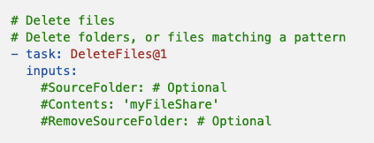
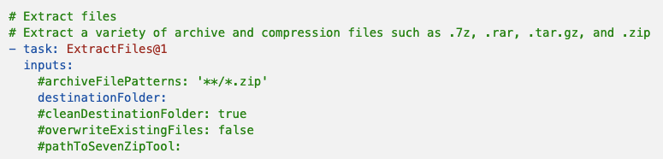
Pipeline Orchestration - Steps
Good to know!
The steps are the smallest building block of the pipeline. Steps consist of tasks and scripts.
Steps run under jobs. If no job is explicitly specified, at runtime, the pipeline assgins an automatically generated job for the listed set of steps.
Tasks: simply packaged script or procedure that has been abstracted with a set of inputs.
Scripts: we all know what scripts are…
YAML Syntax
steps:
- task: taskName@taskVersion
inputs:
#taskSpecificInput
condition: customCondition
timeoutInMinutes: 120
- script: |
echo “Hello World!”

Slide 13
Pipeline Orchestration – Steps (2)
By default, Azure DevOps offers a wide variety of tasks which cover fundamental build and deployment scenarios.
All available out-of-the-box tasks can be found by browsing the catalog:
https://docs.microsoft.com/en-us/azure/devops/pipelines/tasks/?view=azure-devops
More community tasks can be found by consulting the marketplace:
https://marketplace.visualstudio.com/azuredevops

Slide 14

Demo time
Pipeline orchestration
Notes:
1. Create a new branch from the ‘main’ one from the https://dev.azure.com/Iustin-IulianSerban/DevSchool/_git/Pipeline-orchestration?path=%2Fpipeline.yaml&version=GBmain&_a=contents
2. Write code for: a stage with a job and a bash step
3. Create and run the pipeline ( Explain that when pipeline is single stage , GUI does not show the stage)
4. Add another stage with a job and a step
5. Re-run the pipeline and highlight the differences
6. Modify the code and add a dependsOn instruction to make stages run in parralel and not sequentially
7. Modify the code and make the second stage run only if the previous one failed (use conditions)

Slide 15





Templates
Long story short…
That’s not right!
I do the same things over and over!
Template
B
T
D
John Plumberman
One Company inc.
Input
Can you help me build test and deploy my authentication app?
Can you help me build test and deploy my transtactions app?
Can you help me build test and deploy my cow abduction app?
Mark on-Localstone
Sofia Von der manual-Build
Lawrence the backEndAlien
B
B
T
T
D
D

Slide 16
Templates (2)
Define reusable content
4 types of templates: stage templates, job templates, steps templates, variable templates
Can be nested out to 20 times
template.yaml
pipeline.yaml
stages:
- stage: template_stage
displayName: ‘template stage’
jobs:
- job: template_job
displayName: ‘template job’
steps:
- script: |
echo “Hello World from template”
stages:
- template: /template.yaml
- stage: stage_two
displayName: ‘Stage two’
.
.
.
.

Slide 17
Parameters and Expressions
Input for templates and pipeline files is done using parameters
Parameters can have multiple types: string, number, boolean, object
Parameters are expanded just before the pipeline runs
YAML Syntax
parameters:
- name: parameterName
type: string|number|boolean|object
default: ‘defaultValueofParameter’
displayName: ‘param Display Name’
${{ parameters.parameterName }}

Slide 18
Parameters and Expressions
Runtime of pipelines can be conditioned with various expressions and conditions
Expresions are expanded just before the pipeline runs
IF - ELSE
${{ if <condition> }}:
instructions
${{ else }}:
instructions
EQUALS eq(value1, value2) - Returns true if left value is equal with right value
GREATER THEN gt(value1, value2) - Returns true if left value is greater with right value
CONTAINS contains(value1, value2) - Returns true if left value contains right value
AND and(eq(value1, value2), eq(value3, value4))
EACH
${{ each <value> in <valueSet> }}:
instructions
OR or(eq(value1, value2), eq(value3, value4))

Slide 19
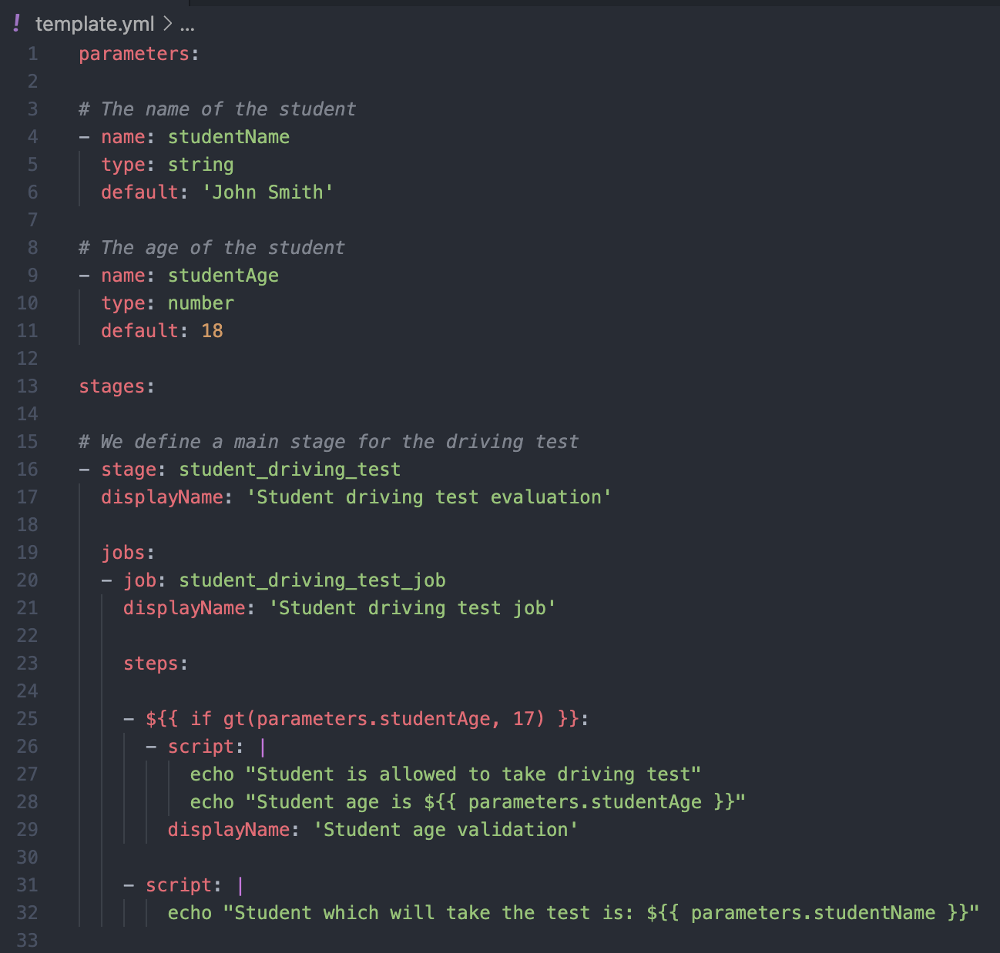
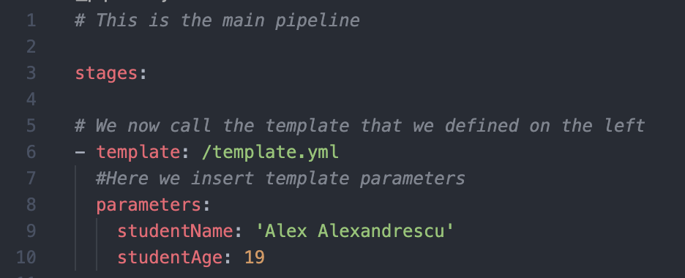
Main Pipeline file

Slide 20








Thank you!
ing.com
@ING_News
LinkedIn.com/company/ING
SlideShare.net/ING
Medium.com/ing-blog
ingwb.com
Facebook.com/ING
YouTube.com/ING
Flickr.com/INGGroup

